Slide 1
SANS

Slide 2
Dynamic IDF Selection
The issue:
IDF selected at start-up
Discrepancy once ws is loaded
LARMOR: LARMOR_Definition.xml
LARMOR_Definition_19000000-20150317.xml
LARMOR_Definition_8tubes.xml
LOQ: LOQ_Definition_20020226-.xml
LOQ_Definition_20010430-20020226.xml
LOQ_Definition_20020226-.xml
LOQ_Definition_20121016-.xml
…
SANS Instrument
SANS2D: SANS2D_Definition.xml
SANS2D TUBES: SANS2D_Definition_Tubes.xml
“Solution” around this issue!
Now:
SANS Instrument IDF is reset if there is a mismatch between the workspace and the SANS Instrument
Diagnostic IDF indicator on “Run” tab indicates which IDF is being used for the instrument

Slide 3
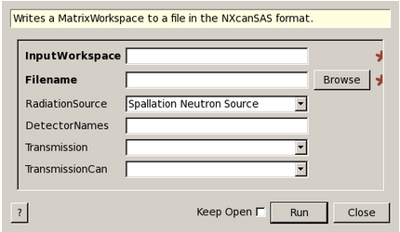
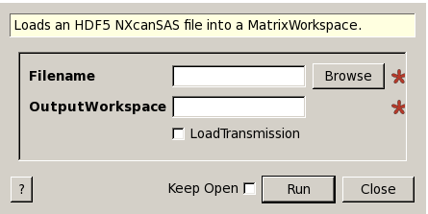
Support for NXcanSAS Format
SaveNXcanSAS
LoadNXcanSAS
Similar interface to SaveCanSAS1D
Handles 2D reduction workspaces
Saves in HDF5 format instead of xml
Optional loading of transmission workspaces
Works best with reduction workspaces which were saved with SaveNXcanSAS
Loaded as point workspaces

